Slide 1
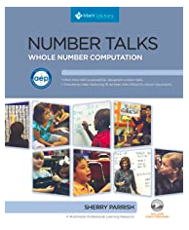
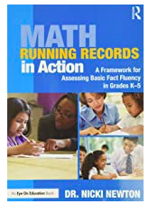
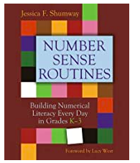
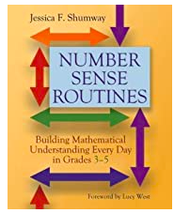
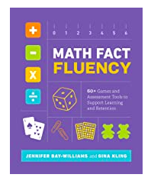
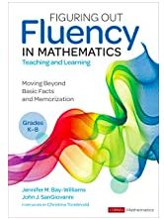
Number Sense and Fluency
Mid Michigan Math Ladies
Notes:
7:00-7:10 for intro

Slide 2
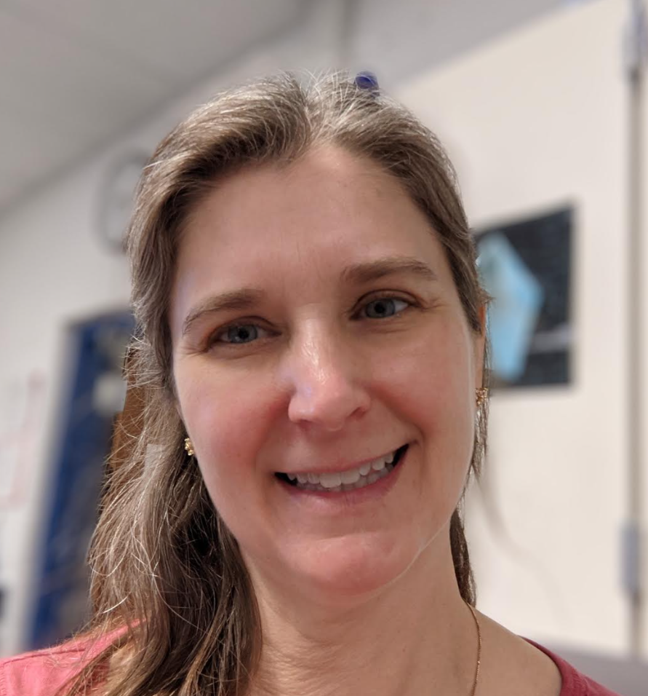
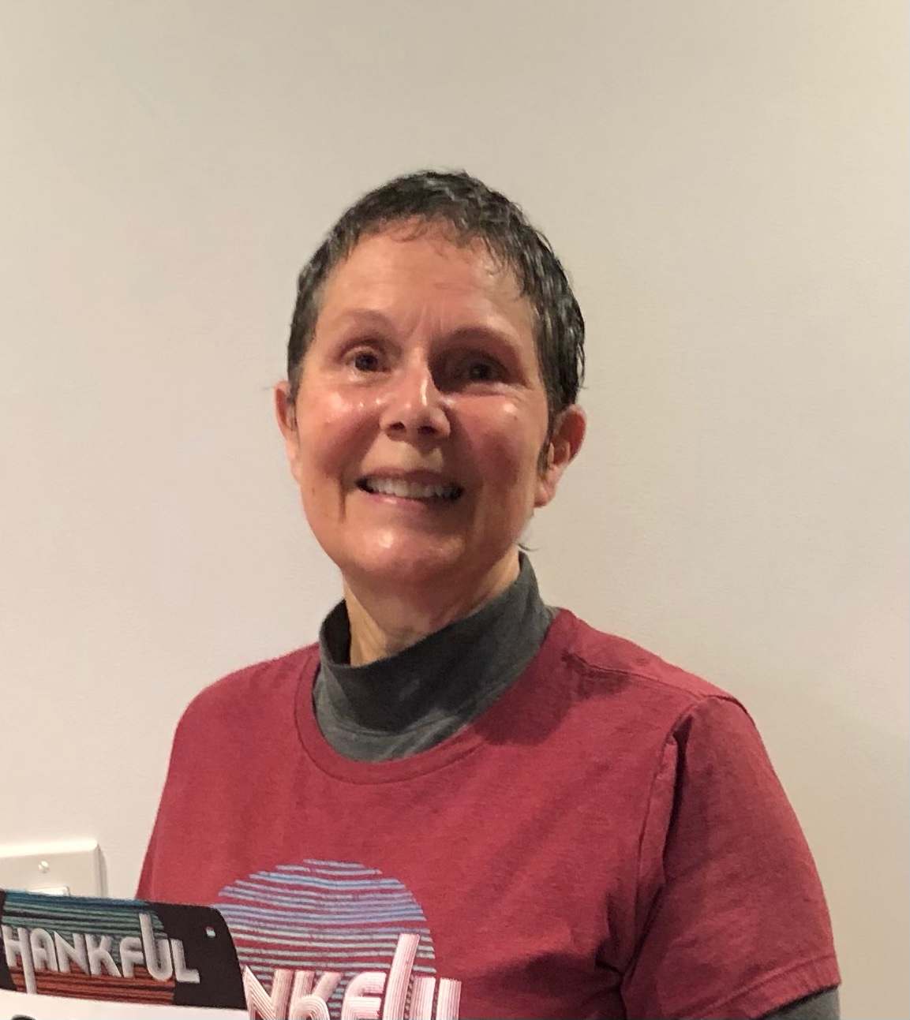
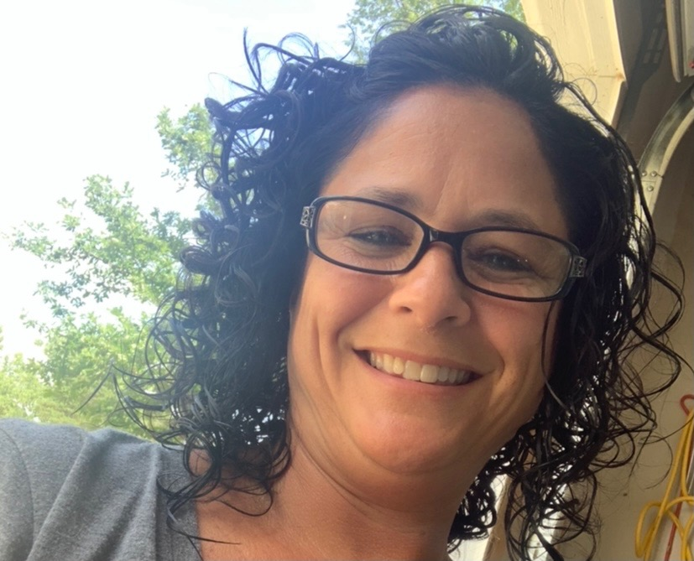
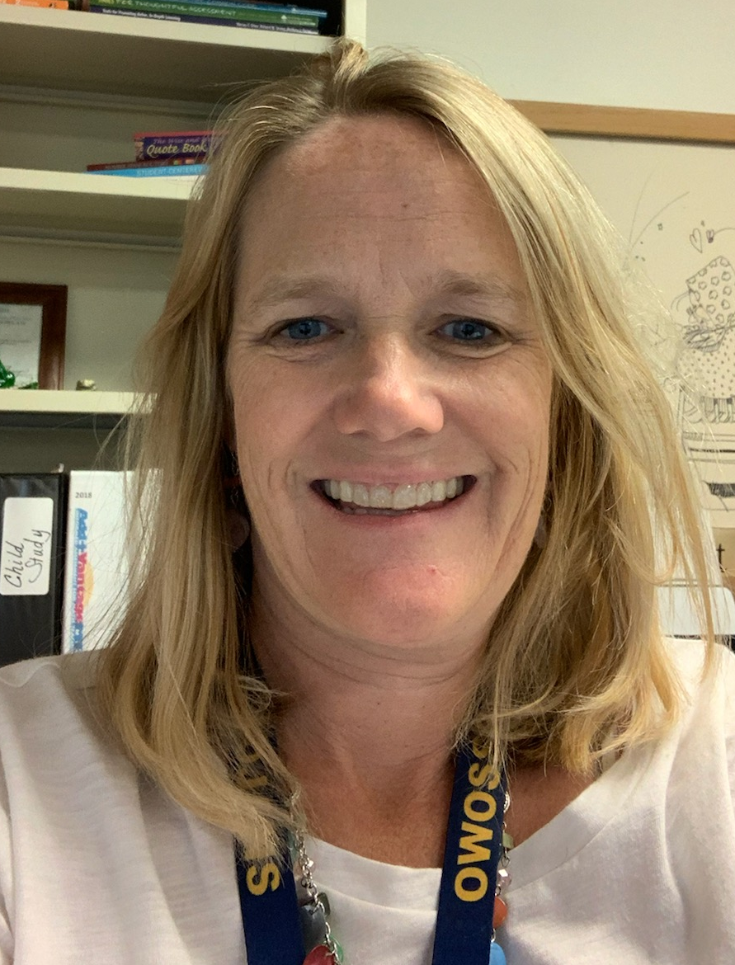
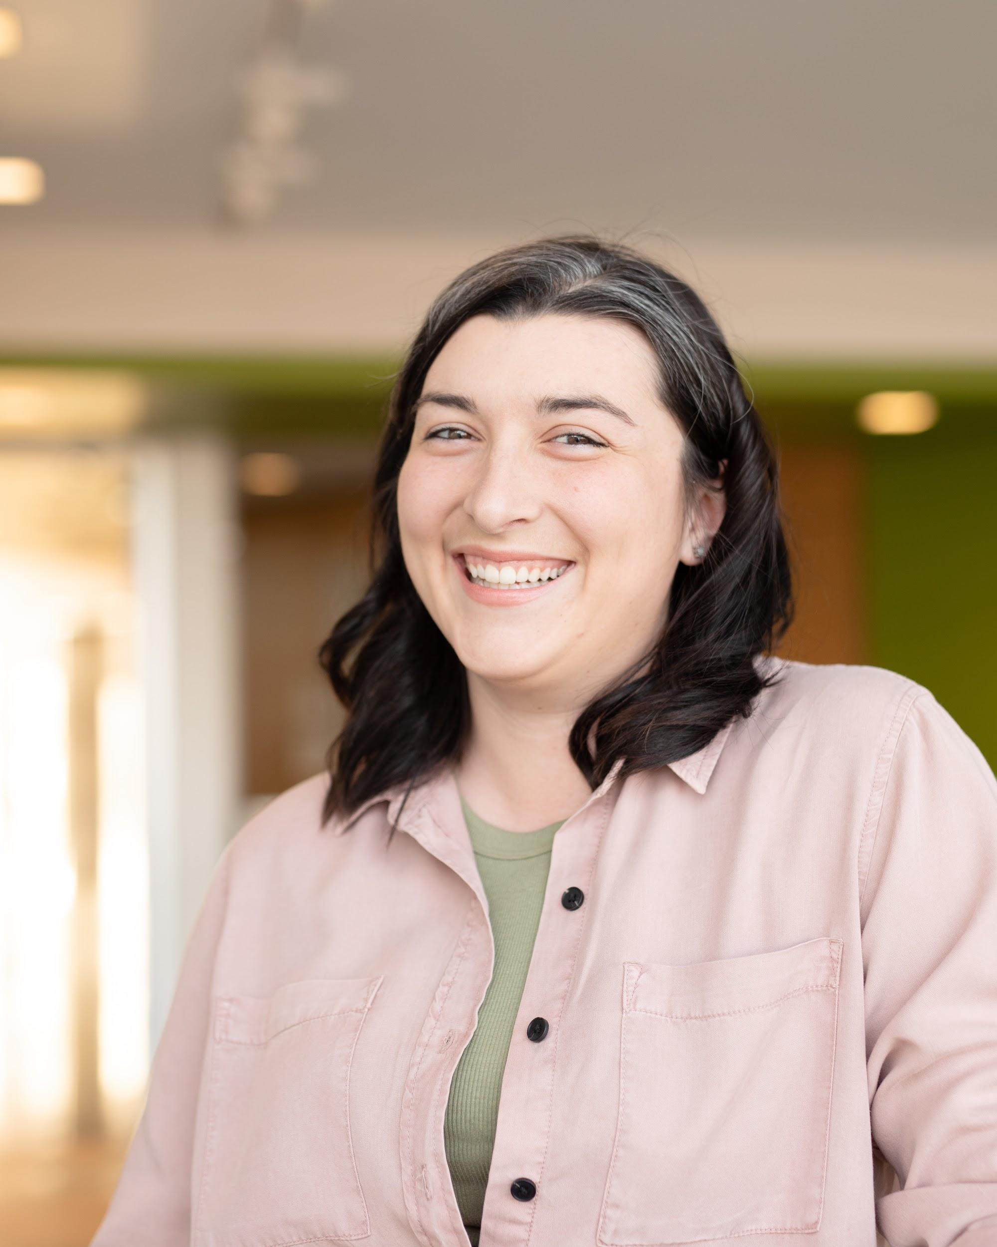
Mid Michigan Math Ladies
Kassie Lawhorne
klawhorne@bathschools.net
Middle School Math
09/10 Region 6 Teacher of the Year
Sheila Bell
37mthldr73@gmail.com
K-6 Math Consultant
Sara Schneeberger
schneebergers@perry.k12.mi.us
Instructional Coach and Interventionist
Michele Bruckman:
bruckman@owosso.k12.mi.us
Title 1 Math Interventionist
Chelsee Schram
chelsee.schram@gmail.com
2nd Grade Teacher
20/21 Region 6 Teacher of the Year
Notes:
Sara Housekeeping: how to ask questions-Q and A button, unable to unmute and put camera on, follow up email with resources and video link, SCECHs-be sure to put in your first and last name and PIC number

Slide 3
Goal for the Evening
Goal for the evening
To provide teachers with the tools to develop strong Number Sense in their students, which in turn will lead to greater Fact Fluency
A copy of this recording, powerpoint and resources will be emailed to you and uploaded to:
https://www.mistemregion7.org/math-recovery
Notes:
Sara
We are ending an unprecedented year, during which we have all worked harder than ever before. This includes not only educators, but students and parents. While we know students are “behind” in math, it is unrealistic to think we can catch them up during this final stretch. Instead, let’s help students develop a strong number sense so that they can go into the next year with a better sense of number.
We will not be able to cover this topic completely. After tonight please send follow up questions and resources needs to us and host another night on May 10th.

Slide 4
So What is Number Sense?
A sense of what number means
Students have a visual model and concrete understanding of quantity
Flexibility, automaticity, and fluidity with numbers
Students are able to solve problems efficiently by using the structure of 5 and 10, place value understandings, composing and decomposing number, and the relationships among numbers
An ability to perform mental math
Students use what they know to solve other problems
Automatic use of math knowledge
Students draw on knowledge and strategies used in the past to solve new problems
Notes:
7:10-7:15 Chelsee
Number Sense- mention this document
A couple of interesting quotes I recently heard that relates to this. (From Pam Harris of course)
“Mental Math isn’t math you do in your head, it’s math you do with your head.”
“Flexibility empowers students to do other things with math much more efficiently.”

Slide 5
So How Does Fact Fluency Connect to Number Sense
Accurate
So much more than speed and memorization. It’s about RELATIONSHIPS!
We want students to know their facts; to have them at their fingertips
Number Sense provides students with the knowledge and structure to think flexibly about numbers.
If I know 8+2=10, then I can use this to figure out that 8+4=12
If I know that 3x8=24, then I can double that to get 6x8.
Notes:
7:15-7:20 Sheila
Fluency with facts and skillful computation is the result of having number sense.
Memorization is just recall without meaning.

Slide 6
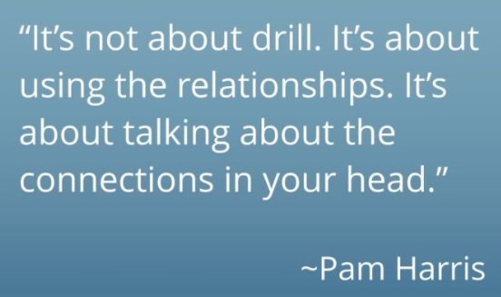
Math is FigureOutAble Home
Math is Figure-Out-Able with Pam Harris
Notes:
https://www.mathisfigureoutable.com/
Sheila

Slide 7
Classroom Routines for Number Sense
Quick Images
Counting Routines
Number Talks
Counting Routines
Number Talks
Notes:
7:20-7:28
Quick Images- Missy
Counting-Sara
Number Talks- Kassie
We are going to take a look at three classroom routines that support number sense.

Slide 8
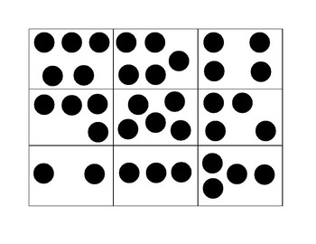
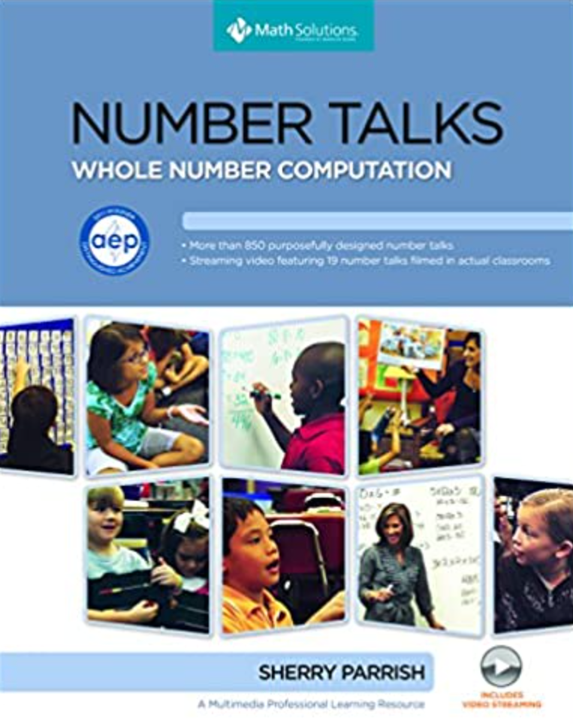
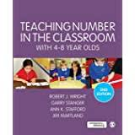
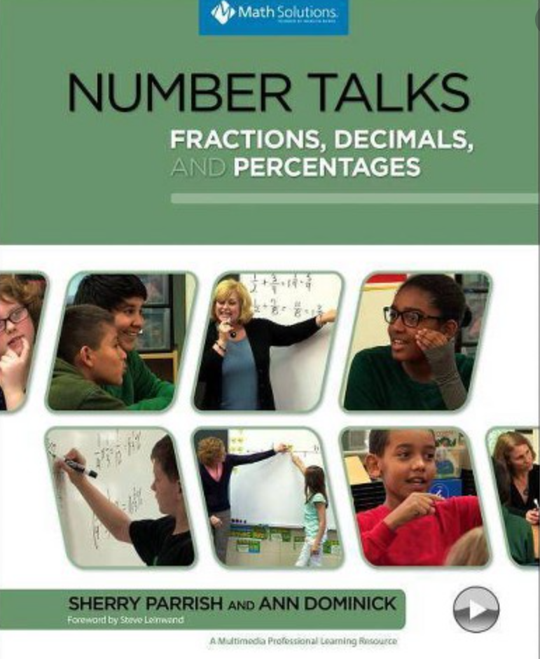
Number Sense Routines
Quick Images
Counting Routines
Number Talks
Regular/Irregular Dot Images
Finger Patterns
Five and Ten Frames
Bead Rack
FNWS
BNWS
Skip Counting
Money
Fractions
Decimals
Addition/Subtraction Strategies
Split, Jump, Split-Jump
Over-Jump
Jump to the Decuple
Compensation
Transformation
Sherry Parrish : Building Numerical Reasoning
Notes:
Discuss difference between Regular/Irregular Dot images, finger patterns
FNWS/BNWS
Addition and Subtraction Strategies

Slide 9
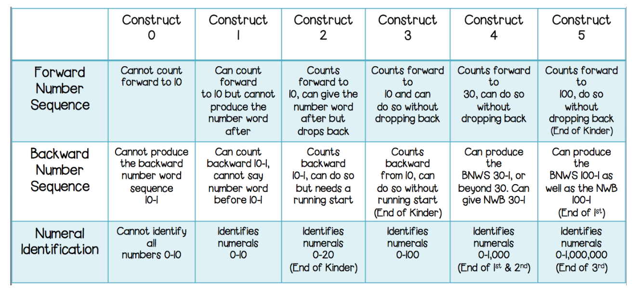
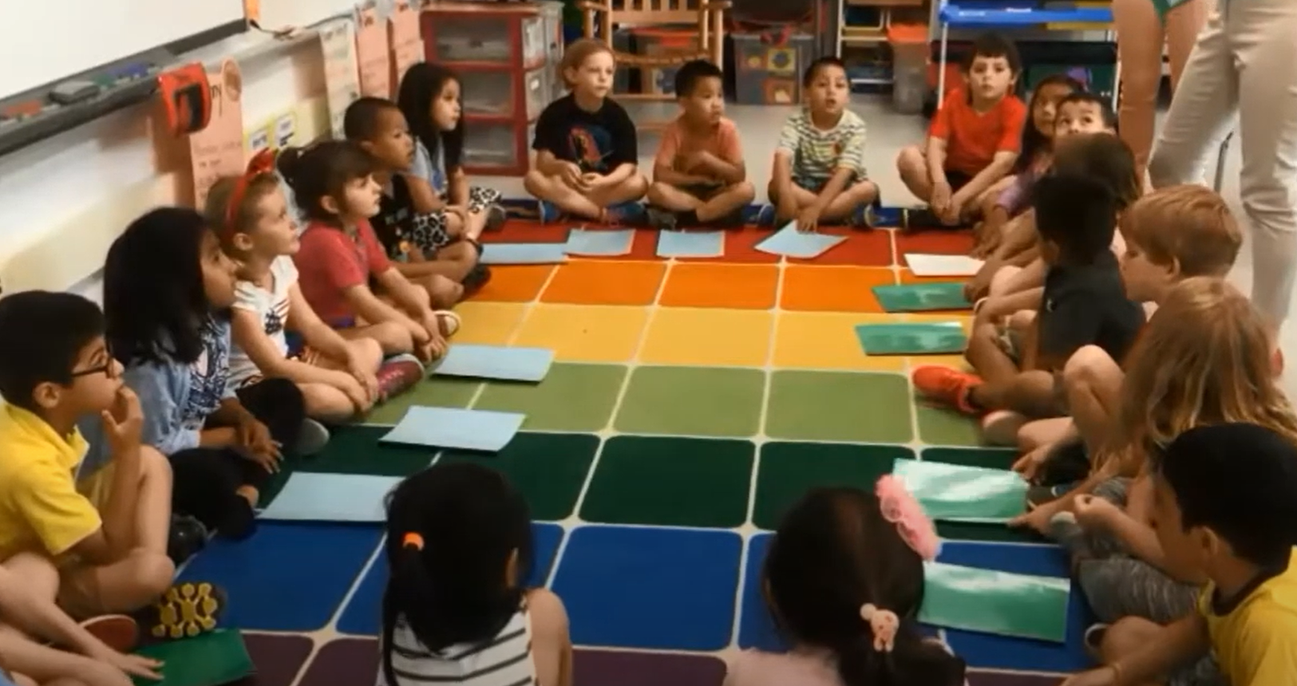
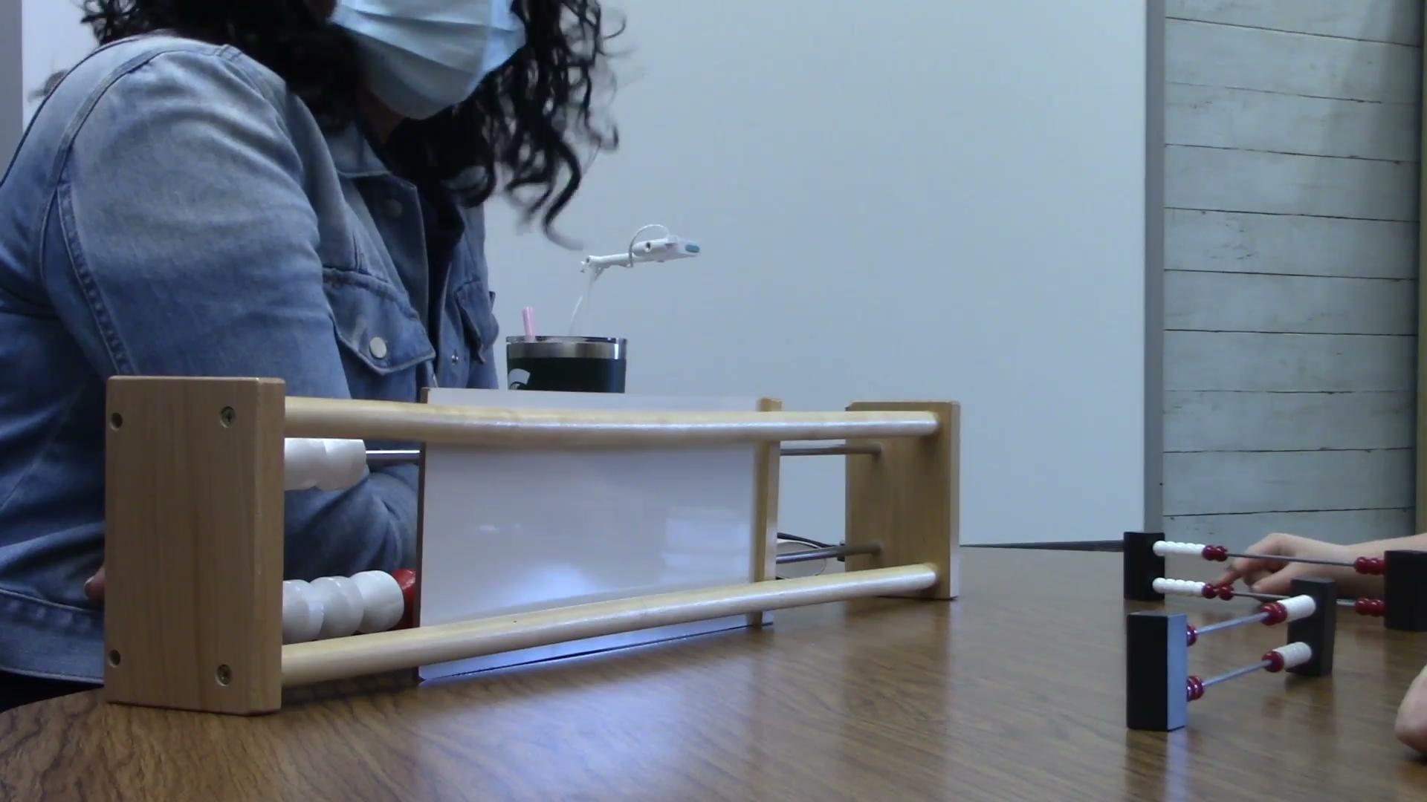
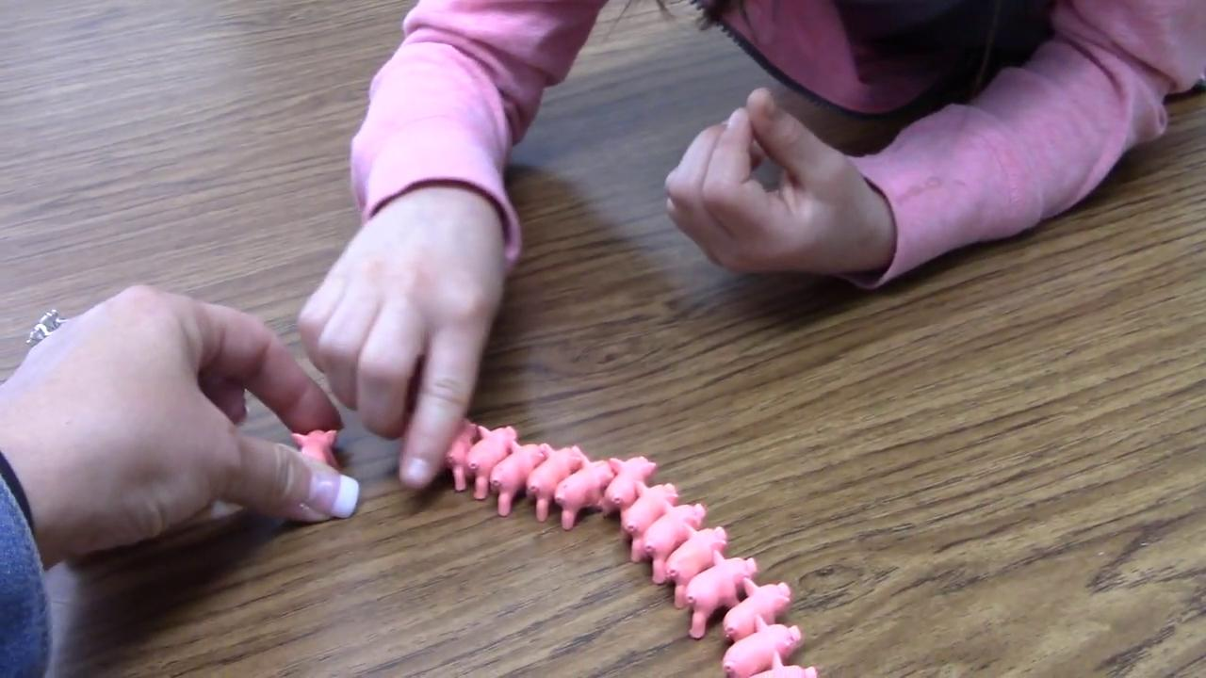
PreK-K
Counting Routine Example
Notes:
7:28-7:33 Sara
https://marissarehder.com/tier-1-math-interventions-for-the-classroom-part-1/
https://www.youtube.com/watch?v=_2XAwY68tIE
Counting Routines should be an everyday part of your math core. We typically recommend 10ish minutes of counting routines each day. These can be forward or backward numbers-always work counting backwards even if Common Core doesn’t say you have too. We don’t recommend working on both one the same day as students could become confused. Also, you should choose numbers that are different starting points.

Slide 10
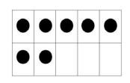
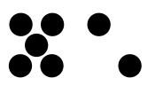
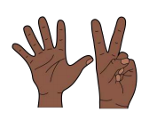
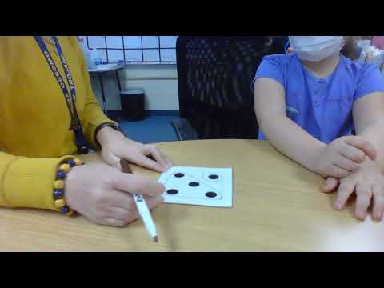
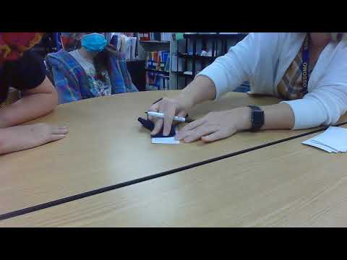
1st Grade
Using Spatial Patterns, Finger Patterns and Five/Ten Frames (pair-wise and five-wise ) helps support composing and decomposing numbers in flexible ways and develop visual images of small numbers
Finger Patterns 1-5, 6-10.
Domino Patterns 1 to 6
Pair-wise patterns, Five-wise patterns
Partitions of 5
Partitions of 10
Addition in range 1 to 10
Subtraction in range 1 to 10 Teaching Number in the Classroom with 4-8 years olds pg 91
RESOURCES LINKS
Teaching Number in the classroom with 4-8 year olds
KNP-Kentucky Center for Mathematics
Math Fact Fluency
Notes:
7:33-7:38 Missy
Structuring numbers is a new and important topic in early numeracy and relates to children’s facility to combine and partition numbers without using counting-by-ones.
Instructional Sequence is in the middle
Early approaches to combining and partitioning in the range of 1 to 10 typically involve using regular and irregular spatial patterns and finger patterns. (flashing, putting hands on top of their head) . Next moving into 5 and ten frames and bead racks.
Students who use 5 and ten as reference points are unlikely to rely on long sequences of counting-by-ones when adding and subtracting. For example 54 is five tens and one five less one, 17 is one ten, one five and 2 more. Any number is no more than twol from a reference point.

Slide 11
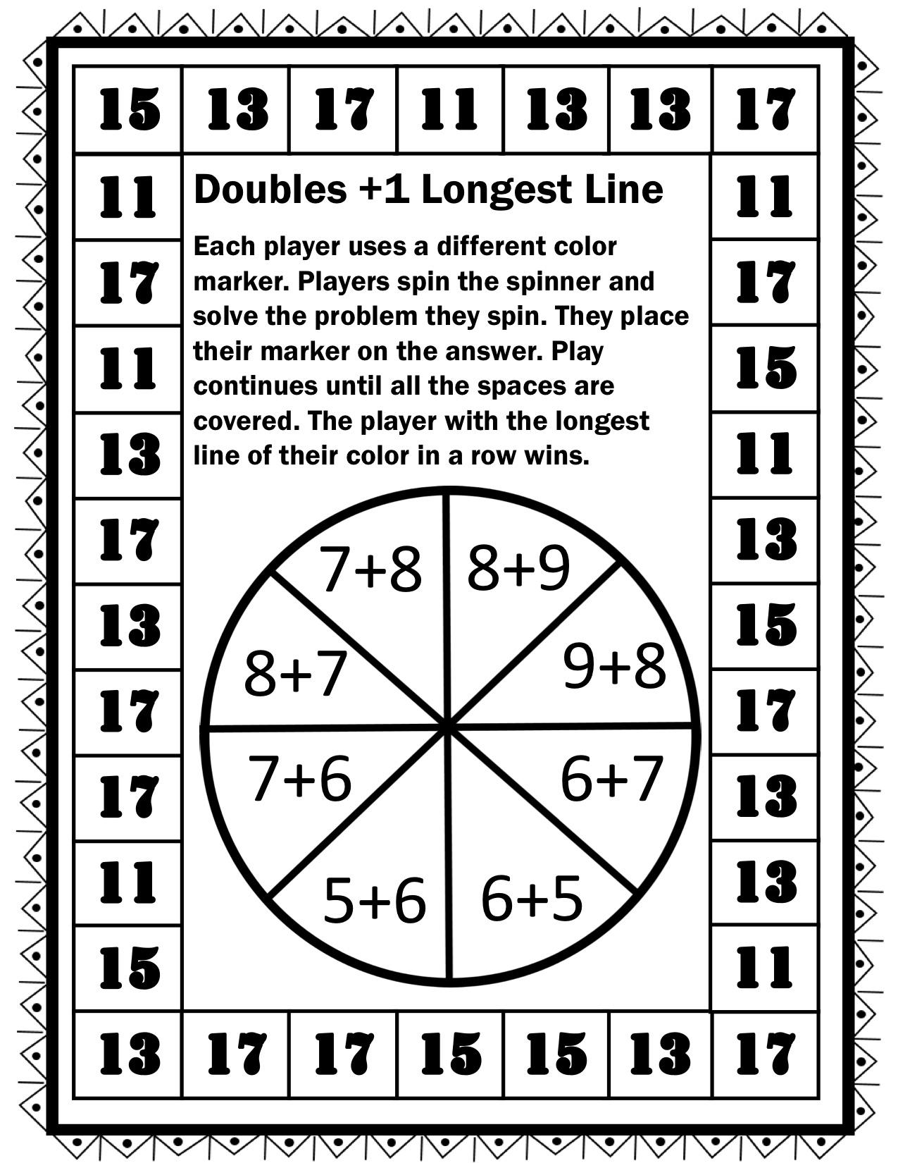
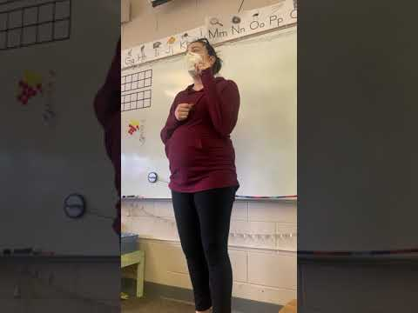
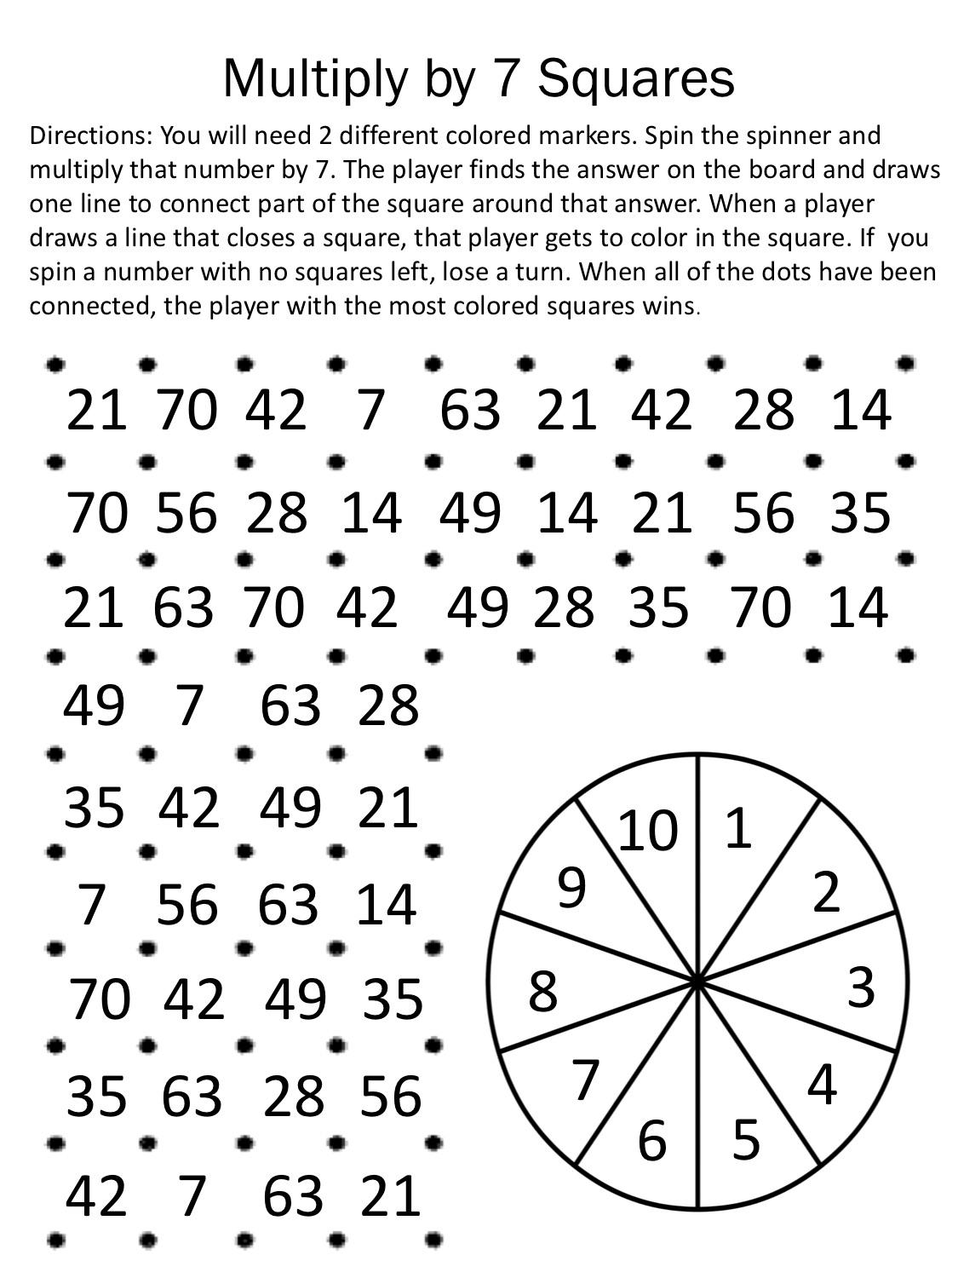
2nd-3rd
Fact Fluency Ideas:
My number is _____, what two (or three) numbers did I add/subtract/multiply/divide to get my number?
struggling students can use tens frames, rekenrek, bead string, counters, fingers, etc.
Notes:
7:38-7:45 Chelsee
https://youtu.be/Tzd2Tf9KHvU
https://www.theatlantic.com/education/archive/2016/04/why-kids-should-use-their-fingers-in-math-class/478053/
https://drive.google.com/file/d/1cYdi5VYoeo2LC93E4cNxf1PDrIKMBRm_/view?usp=sharing
https://drive.google.com/file/d/17H8HM2rWgaErYmcGHG7iEYoJyIkYTbHj/view?usp=sharing

Slide 12
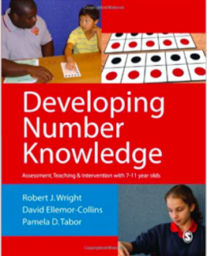
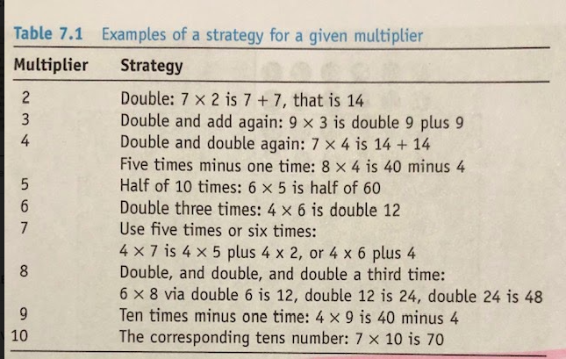
4th-5th
Instructional Sequence:
2s, 10s, 5s, 3s, 4s, 9s, 6s, 8s, 7s
Foundational Facts:
2, 5, 10, 3
Developing Number Knowledge: Assessment,Teaching and Intervention with 7-11 year olds (Math Recovery)
Notes:
7:45-7:50 Sheila

Slide 13
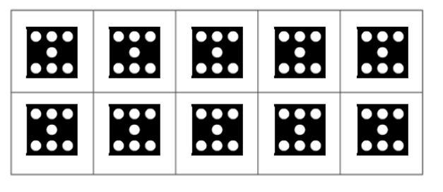
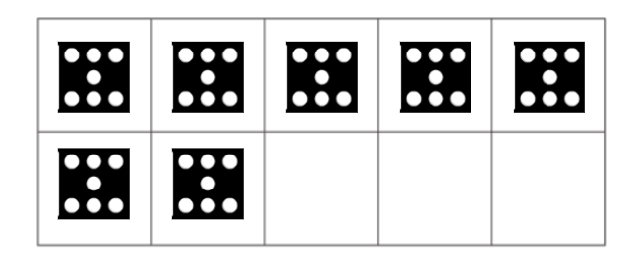
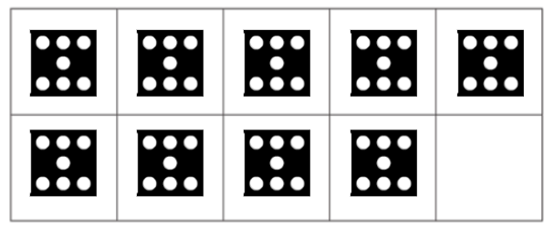
Multiplication 10 Frames
Multiplication 10 Frames
https://youtu.be/UAWXESTq2x0

Slide 14
Middle School
Putting Fluency to Work
Notes:
7:50-7:55

Slide 15
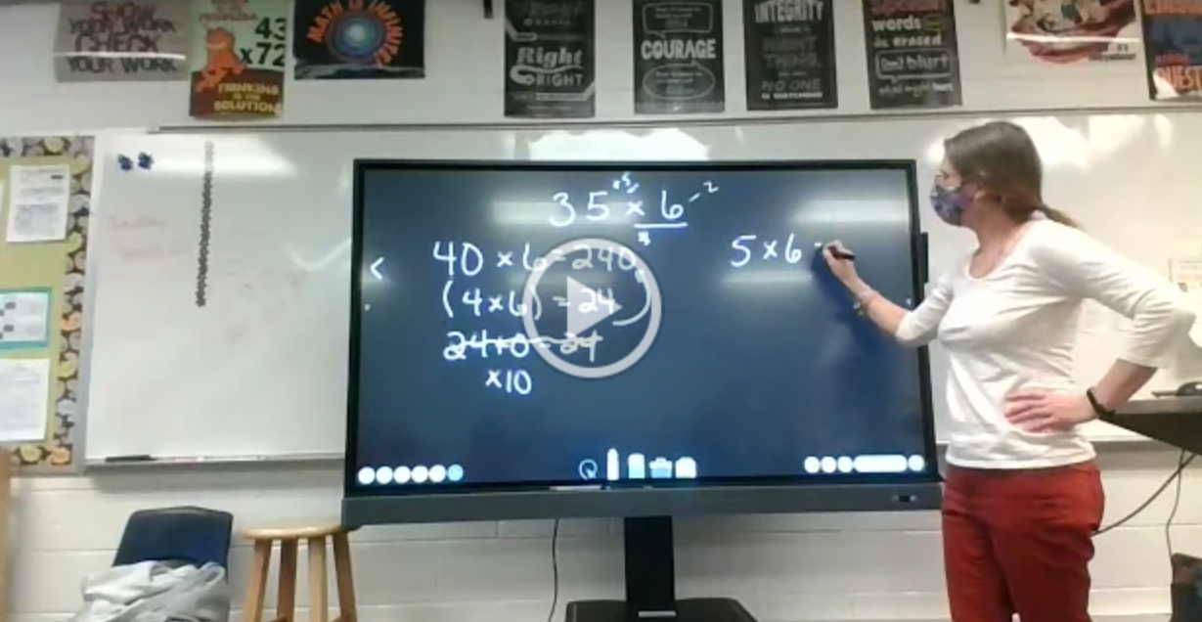
Number Talks: Division
a(b+c) = ab + ac
The problem: 35 x 6
First number talk with multiplication
Fluency will let students naturally develop the Distributive Property and apply it to multiplication and division scenarios. The Distributive Property is an essential tool in solving algebraic problems.
Notes:
https://drive.google.com/file/d/1Ew9pFbkXS1CrZnZ14bYMwOfBWJPoocJx/view?usp=sharing

Slide 16
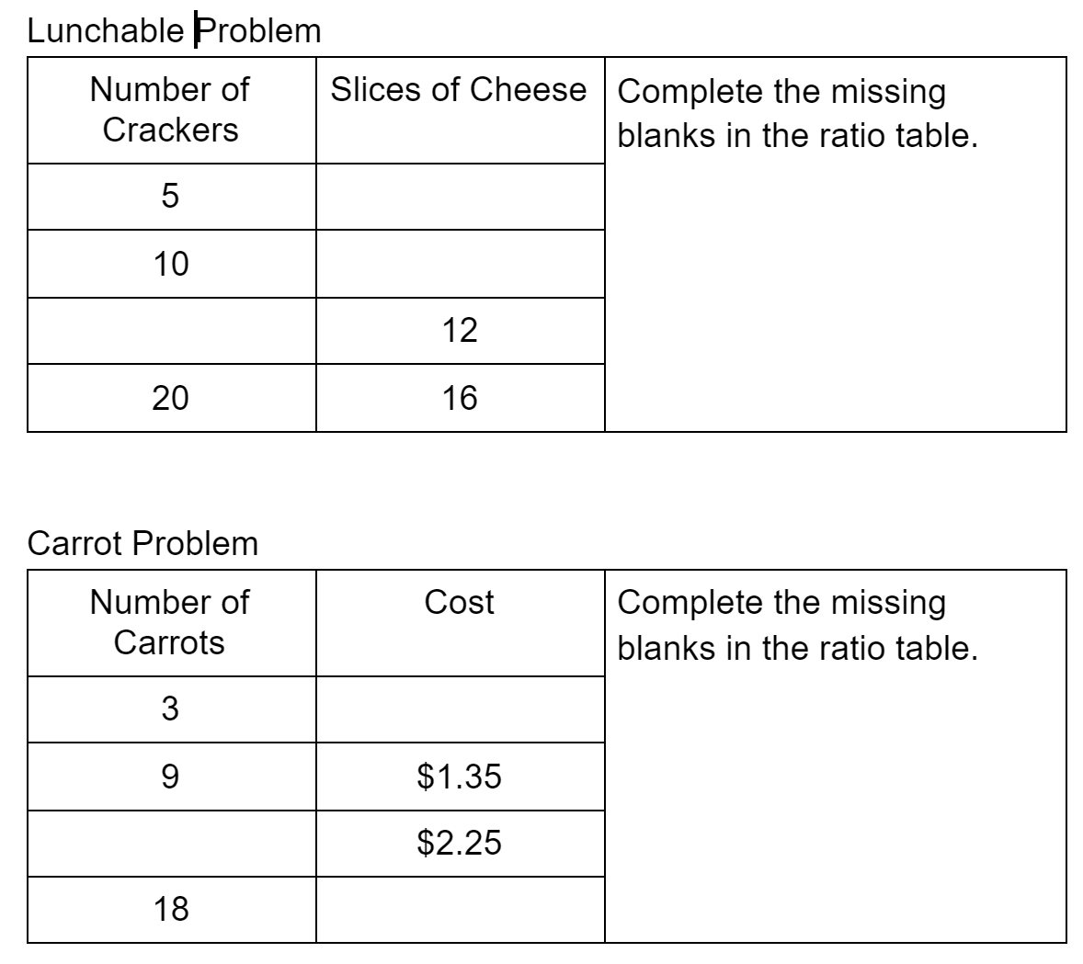
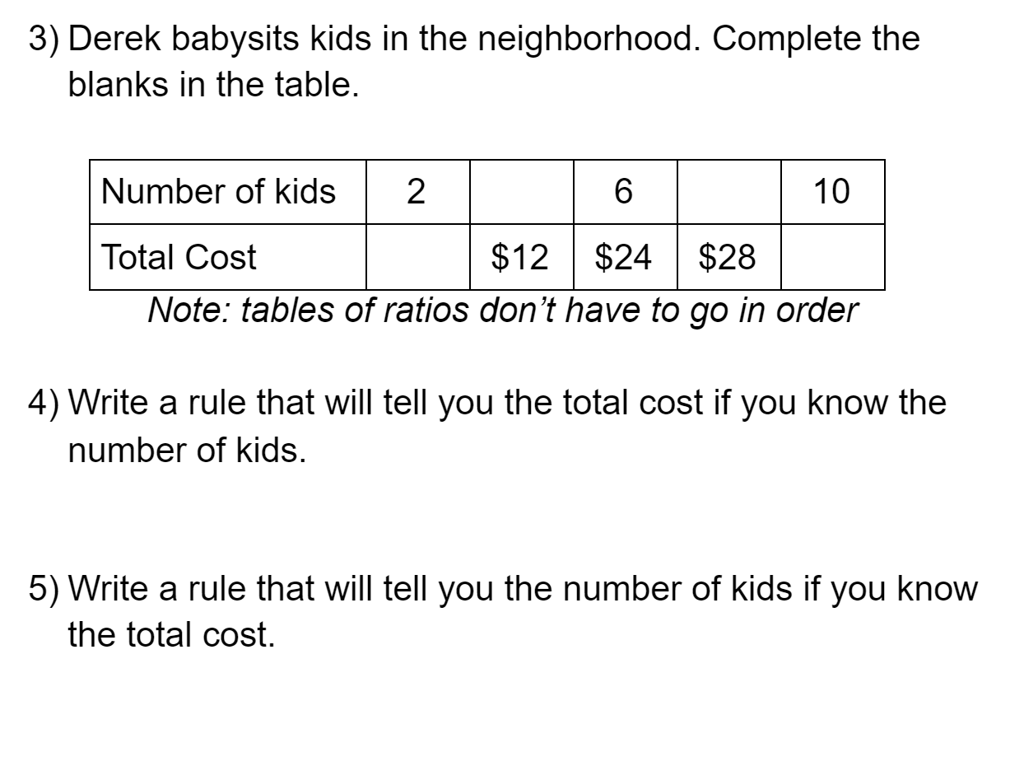
Looking for Relationships in Ratios
Relationships between ratios
Fluency lets students begin to identify the relationships that are the foundation for proportionality.
Relationships within ratios

Slide 17
Fluency-Without-Fear-1.28.15.pdf
Notes:
Fluency without Fear
They resort to skip counting, but that only takes them so far. Then they rely on counting by ones.
755:7:57 Missy

Slide 18
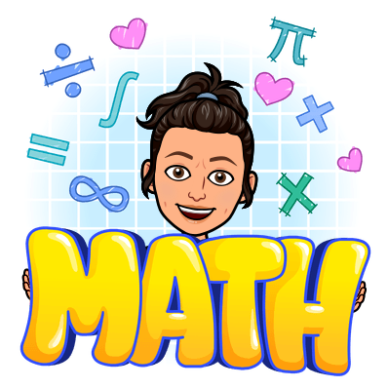
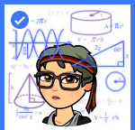
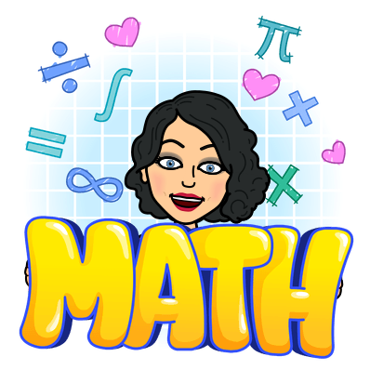
Thank you!!
Survey Link
Chelsee Schram
Michele Bruckman
Sara Schneeberger
Kassandra Lawhorne
Sheila Bell
Mid Michigan Math Ladies
Notes:
7:57-8:00 Chelsee

