Slide 1
Number Sense and Fluency Pt 2
Mid Michigan Math Ladies

Slide 2

Agenda
Number Sense and Fluency
Visual Images
Counting Routines
Number Talks
Grade Level Games
Fluency Flows from Strong Number Sense

Slide 3

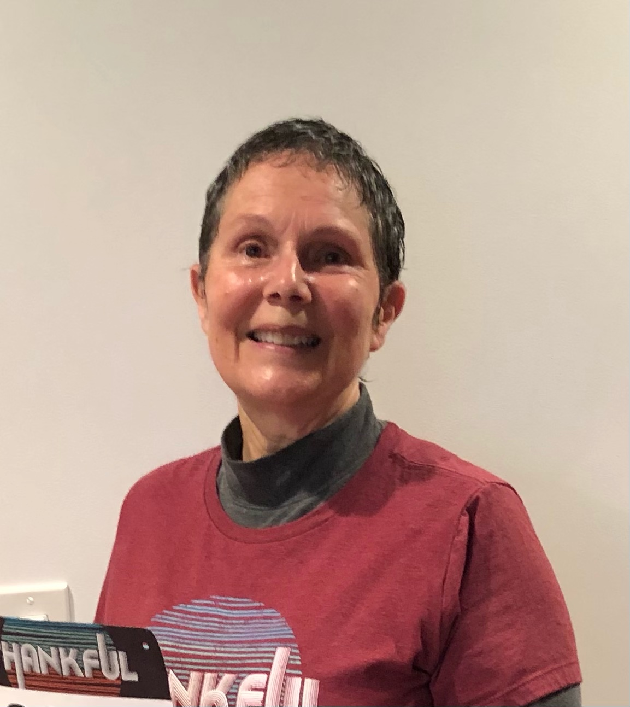

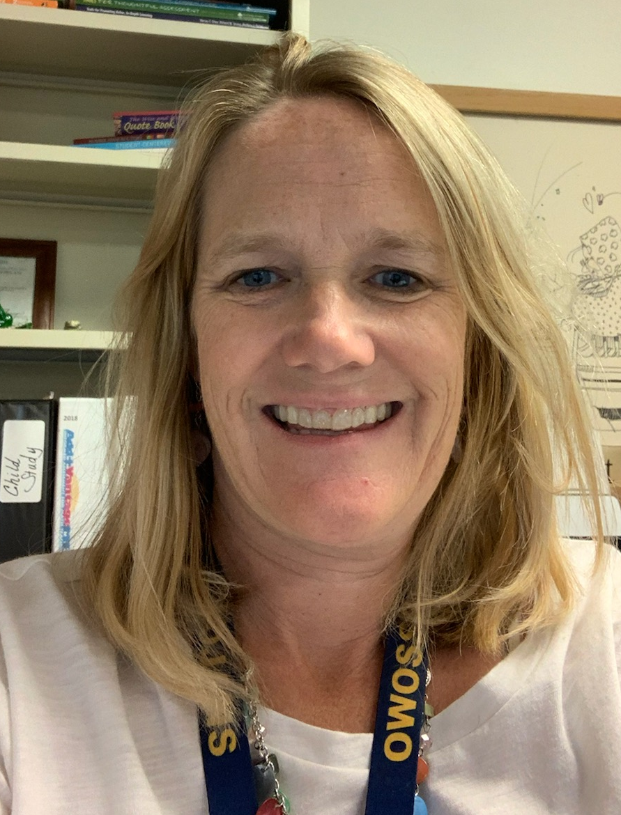

Mid Michigan Math Ladies
Kassie Lawhorne
klawhorne@bathschools.net
Middle School Math
09/10 Region 6 Teacher of the Year
Sheila Bell
37mthldr73@gmail.com
K-6 Math Consultant
Sara Schneeberger
schneebergers@perry.k12.mi.us
Instructional Coach and Interventionist
Michele Bruckman:
bruckman@owosso.k12.mi.us
Title 1 Math Interventionist
Chelsee Schram
chelsee.schram@gmail.com
2nd Grade Teacher
20/21 Region 6 Teacher of the Year
Notes:
Housekeeping: how to ask questions-Q and A button, unable to unmute and put camera on, follow up email with resources and video link, SCECHs-be sure to put in your first and last name and PIC number

Slide 4
Number Sense
A sense of what number means
  Students have a visual model and concrete understanding of quantity
Flexibility, automaticity, and fluidity with numbers
  Students are able to solve problems efficiently by using the structure of 5 and 10, place value understandings, composing and decomposing number, and the relationships among numbers
An ability to perform mental math
  Students use what they know to solve other problems
Automatic use of math knowledge
  Students draw on knowledge and strategies used in the past to solve new problems
Notes:
5 mins - Chelsee
With just a few weeks left….
Maybe a brief description as a review?
Link to Number Sense Document: https://docs.google.com/document/d/1ZAgz7pBqJ2xQAlNuLFXT2I9o2RTTgqzHk4QFyDE2p5I/edit?usp=sharing

Slide 5
Quick Images

Slide 6


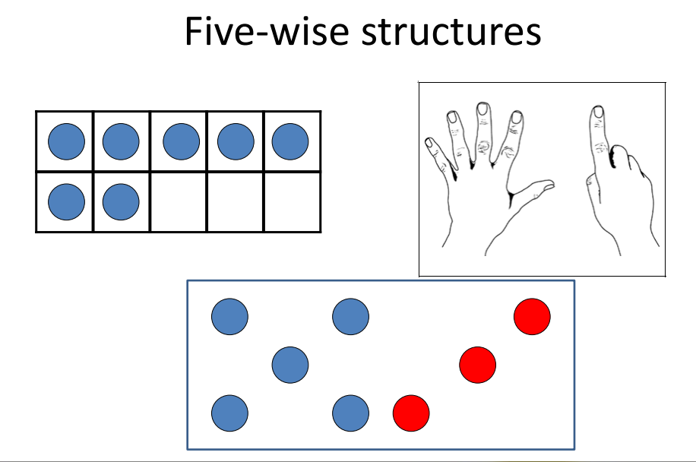
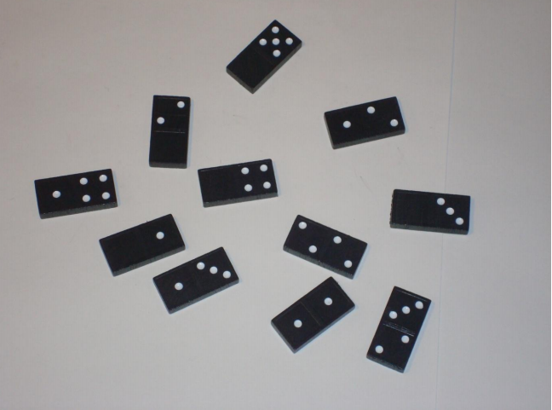
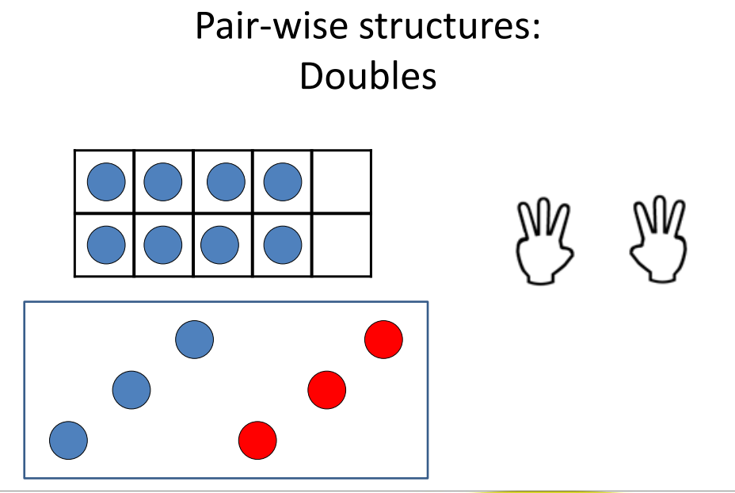



Quick Looks, Finger Patterns and Subitizing
Resources to get you started
Click on an image to get resource
Why is this important?
How to Use Subitizing/ 5 different ways
Subitizing. What is it? Why we teach it?
Notes:
*images are hyperlinked
10mins -Missy
What if we describe quick images, show some, and then actually do them as a panel to model what it looks like?
Purpose:
-regular/irregular dot patterns help support the student to move to more sophisticated strategies in addition/subtraction by using imagery to represent quantities
-finger patterns supports the student with early understanding of small doubles, plus 5 and use of tracking for counting based strategies
-structuring provides readiness for using 5 and 10 for reference numbers when using non count by 1 strategies. Structuring is the way to support students in moving to more sophisticated addition/subtraction strategies.

Slide 7
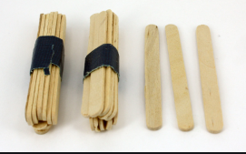
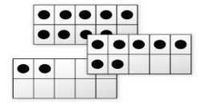
Structuring Numbers
Progression - “Teaching Number in the Classroom with 4-8 Year Olds”
“Developing Number Knowledge; Assessment, Teaching & Intervention with 7-11-Year Olds”
Structuring 1-20
Finger Patterns 1-10
Dice Patterns/irregular dot patterns
Pair-wise patterns to 10
Partitioning 5 and 10
Five-wise patterns 6 to 10
Addition and subtraction in range 1 to 10
Pair-wise patterns to 20
Five-wise patterns to 20
Ten-wise patterns to 20
Addition and Subtraction using pairs, fives and tens
Conceptual Place Value
Incrementing/decrementing by tens on the decuple, off the decuple, and by tens and ones
Higher Decade Addition and Subtraction
Jump within a decade
Jump forward from/back to the decuple
Jump forward to/back from the decuple
Jump across a decuple
Notes:
Missy
Developing knowledge in the three foundations (structuring 1-20, conceptual place value, and Higher decade addition and subtraction) they will be able to grapple with 2-digit tasks and deise their own mental strategies (I am focusing the use of structuring)
Purple Book Link: https://www.amazon.com/Teaching-Number-Classroom-Year-Recovery/dp/1446282694/ref=asc_df_1446282694/?tag=hyprod-20&linkCode=df0&hvadid=312065696873&hvpos=&hvnetw=g&hvrand=13554054705804557097&hvpone=&hvptwo=&hvqmt=&hvdev=c&hvdvcmdl=&hvlocint=&hvlocphy=9017221&hvtargid=pla-492128003669&psc=1&tag=&ref=&adgrpid=61316180399&hvpone=&hvptwo=&hvadid=312065696873&hvpos=&hvnetw=g&hvrand=13554054705804557097&hvqmt=&hvdev=c&hvdvcmdl=&hvlocint=&hvlocphy=9017221&hvtargid=pla-492128003669
Red Book Link: https://www.amazon.com/Developing-Number-Knowledge-Assessment-Intervention/dp/0857020617/ref=asc_df_0857020617/?tag=hyprod-20&linkCode=df0&hvadid=366282405567&hvpos=&hvnetw=g&hvrand=18276531640637373510&hvpone=&hvptwo=&hvqmt=&hvdev=c&hvdvcmdl=&hvlocint=&hvlocphy=9017221&hvtargid=pla-433202927198&psc=1&tag=&ref=&adgrpid=78795691600&hvpone=&hvptwo=&hvadid=366282405567&hvpos=&hvnetw=g&hvrand=18276531640637373510&hvqmt=&hvdev=c&hvdvcmdl=&hvlocint=&hvlocphy=9017221&hvtargid=pla-433202927198

Slide 8
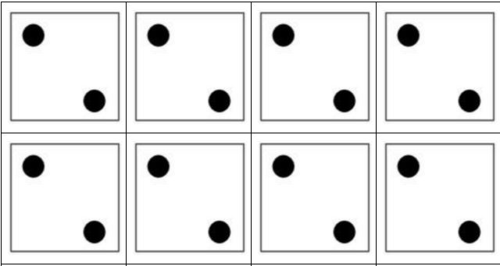
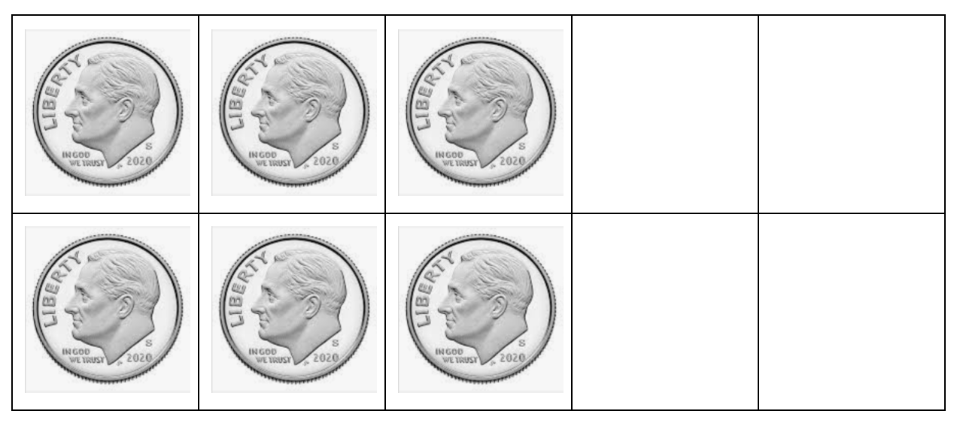
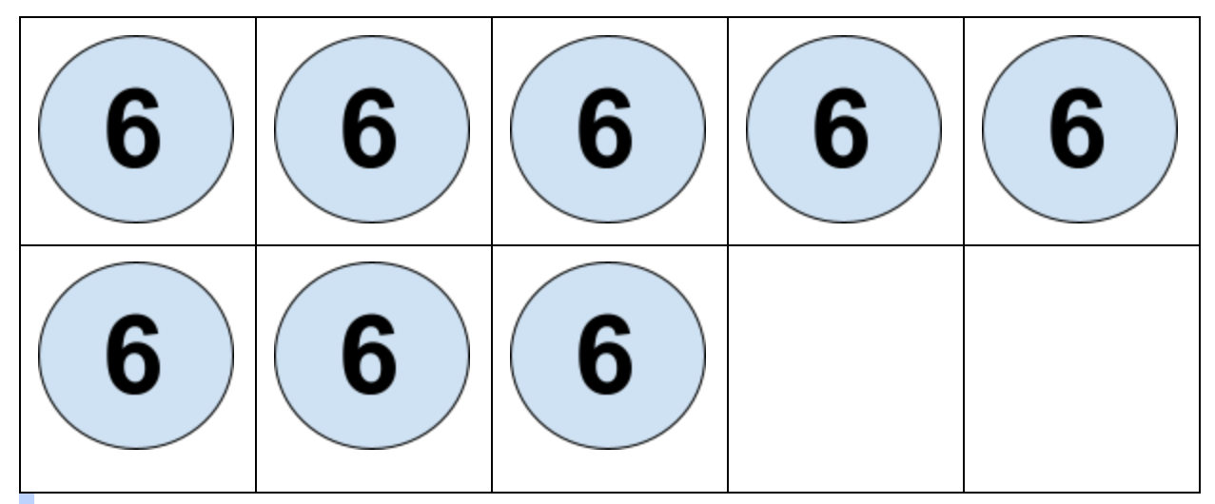
“Developing Number Knowledge; Assessment, Teaching & Intervention with 7-11-Year Olds”
Multiplication and Division
Sequence of Multiples 2s, 5s, and 3s
Repeated Equal Groups
Structuring numbers multiplicatively
Developing Multiplicative Strategies for 1-digit Factors
Develop automatized knowledge of basic multiplication/division facts
2s, 10s, 5s, 3s, 4s, 9s, 6s, 8s, 7s
Notes:
Students should not be pressed to memorize initially, rather, they need extensive opportunities to develop multiplicative non-counting strategies before developing automaticity.

Slide 9
Counting Routines
Getting Started w Counting Routines
Forward and Backwards by 10 on and off decade
10, 20, 30…
37,47,57…
108,98,88...
By 1’s from different start pts.
0,1,2,3,4,5,.......
16,17,18, 19, 20…..
118,119,120,121….
Fractions, Decimals, Percents
2 ½, 2 ¾, 3, 3 ¼ …
.07, .08, .09, .10...
Backwards by 1’s from different start pts.
19, 18, 17, 16…
84,83,83,82...
Forward and Backwards by Multiples
3,6,9,12,
66,72,78
99.90.81...
Notes:
5 mins - Sheila
Forward/backward number sequence by 1’s, 2’s, 5’s, 10’s, etc from various start points. Why? Helps with development of number sense, adding and subtracting, and multiplicative reasoning.
Do any time have a transition.

Slide 10
Counting Routines
To 5
I have 3, I need?
To 10
I have 8, I need ?
To 20
I have 13, I need?
To 100
I have 37, I need?
I Have, I Need…..
Notes:
Sheila
Don’t forget other combinations. Could use fractions. I have ⅛. I need… to make a whole.
Not really a counting routine, but also a number sense activity that you can do during a transition. Helps to build number sense, structure, and flexible thinking.

Slide 11
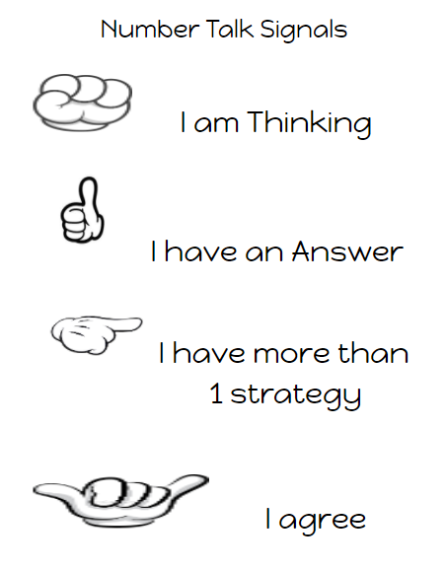
Number Talks
Grade3-5_Number_Talks copy.pdf
Grade1_Number_Talks.pdf
number_talks_second_grade_resource.pdf
Grade K Number Talks Resource bps copy.pdf
Number Talk Jamboard
Upper Elementary - Middle School
Notes:
20 mins- Kassie and Sara
https://docs.google.com/document/d/1ocECptd9ZQhUtx-cIFpXtkJhq4Wjzgjb4BLT42Gw6x8/edit?usp=sharing

Slide 12
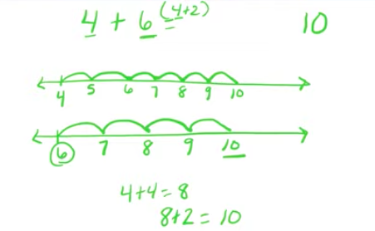
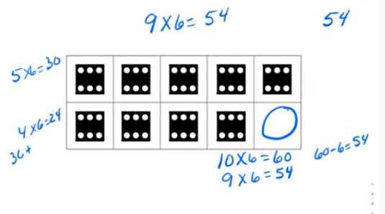
Number Talks Videos
BK/K: https://www.youtube.com/playlist?list=PLEBpy8VH1kn8qhDjRZTlghcThjpuWFSm5
1st/2nd:
https://www.youtube.com/playlist?list=PLEBpy8VH1kn8yjK0agCI8wvOMlMG0Hi9S
3rd:
https://www.youtube.com/playlist?list=PLEBpy8VH1kn_0q_uWIkPGSk4syNXfPpXX
4th/5th/6th:
https://www.youtube.com/playlist?list=PLEBpy8VH1kn-PuUHDfvXtgxBMrxWufhJj
Notes:
Video examples of number talks at each grade level.

Slide 13
Fluency Games
Free Resources | US Math Recovery Council®
Strategic
Accurate
Efficient
Flexible
Notes:
Chelsee- 5 mins

Slide 14
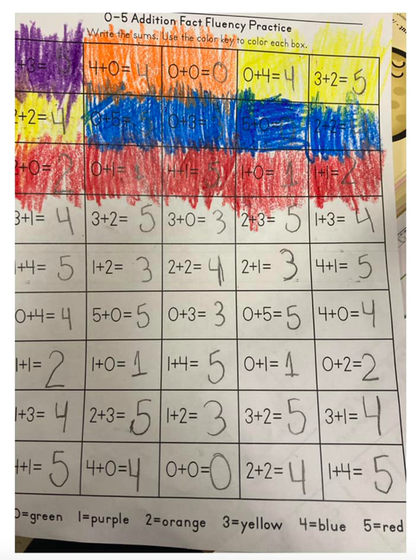
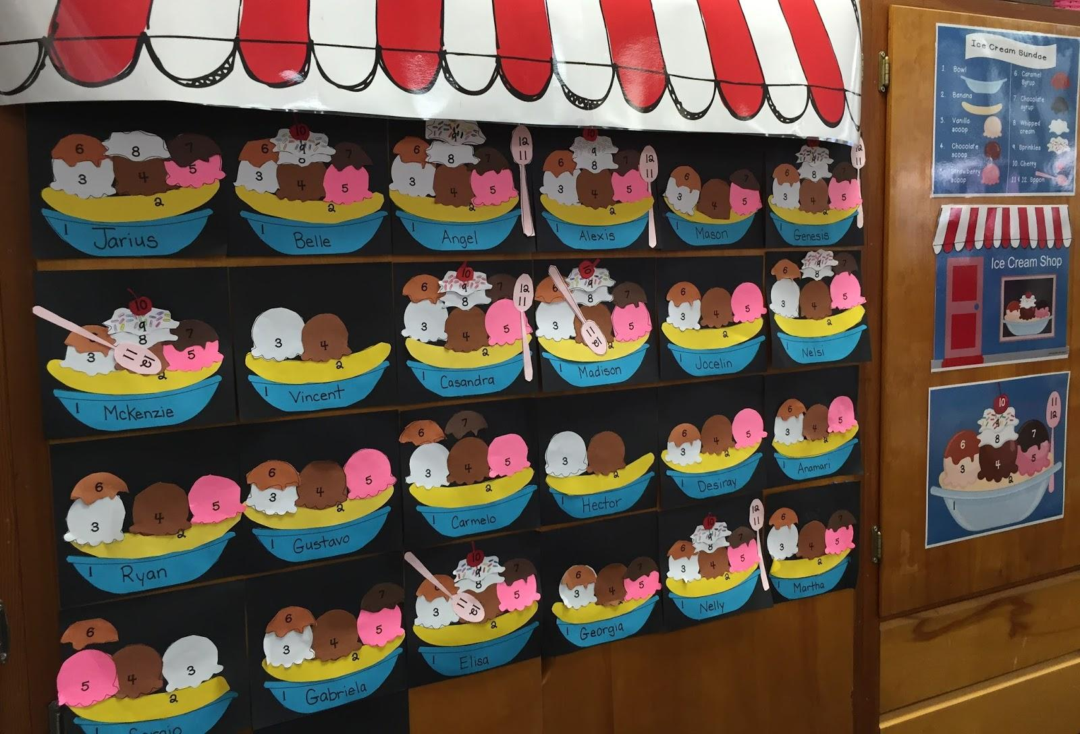
Developing fluency?
Notes:
Chelsee Poll: Developing Fluency

Slide 15
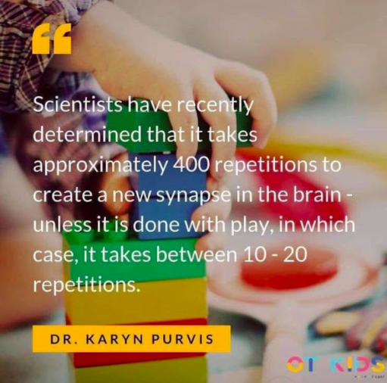
Notes:
Chelsee

Slide 16
Fluency
So much more than speed and memorization. It’s about RELATIONSHIPS!
  We want students to know their facts; to have them at their fingertips
  Number Sense provides students with the knowledge and structure to think flexibly about numbers.
If I know 8+2=10, then I can use this to figure out that 8+4=12
If I know that 3x8=24, then I can double that to get 6x8.
Notes:
Chelsee
Accuracy, flexibility, efficiency, strategic

Slide 17
Addition & Subtraction
Games
Combinations to 10 Bingo
Combinations-to-10-Bingo.pdf
How many more to make 5? Kindergarten and Pre-school Math Fun
How Many More to Make 5
Add to Get 60
AVMR-Add-to-Get-60.pdf
62 Minus Board Game
AVMR-62-Minus.pdf
Fluency Article
Fluency with Basic Addition.pdf
https://gfletchy.com/2019/04/09/building-automaticity-with-base-ten-cards/
+/- Cards
Notes:
Sheila
LIFN connection If struggling with addition/subtraction, look at where deficit is. NWS? Structure? Practice what they know to make permanent. Give students supportive materials such as 5,10,20 frames, bead rack, 100 bead string, or change the range of numbers. All play the same game, but at their zone of proximal development.

Slide 18
Number Word Sequence
Go Fish/Memory with 9, 10, 19, 20, 29, 30, 39, 40, etc.
How to Play Treasure Hunt: Fun Math Card Game
Treasure Hunt
Disappearing Numbers: Multiplication Support
Disappearing Numbers
Number Sequence with Cups: 1-10
Number-Sequence-with-Cups.pdf
Notes:
Chelsee
Use the same games just extend the range

Slide 19
Structuring
How to Play Snap 10
Snap 10
Make 5 Bingo: Fun Math Game Kindergarten and Grade 1
Go Fish/Memory with 10 buddies, 20 buddies
Arithmetic Rack Bingo 5/10/20
Shake and Spill Low Doubles
Shake and Spill High Doubles
Notes:
Missy
Provide manipulatives as needed, taking them away will make it more complex

Slide 20

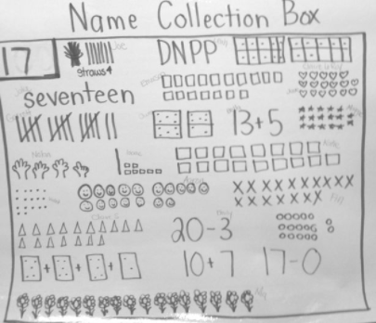
Multiplication and Division
How to Play Quick Draw: Fun Math Card Game
Quick Draw Multiples
24
Multiplication Bingo/Factoring Game
Fun Multiplication Game: Mini -Multo
Mini-Multo.pdf
https://gfletchy.com/2019/03/17/multiplication-subitizing-cards/
Three Steps to Mastering Multiplication Facts copy.pdf
Notes:
Kassie
Name Collection Box: https://www.youtube.com/watch?v=Kf2tIgCcKcs

Slide 21
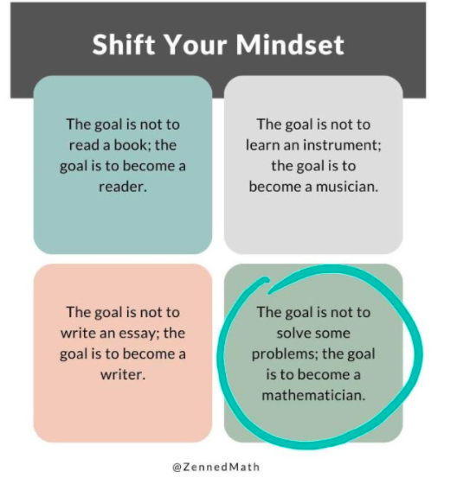
Notes:
Sara:
The focus shouldn’t be getting the answer, the focus should be how we get the answer

Slide 22

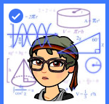



Thank you!
Survey Link
Chelsee Schram
Michele Bruckman
Sara Schneeberger
Kassandra Lawhorne
Sheila Bell
Mid Michigan Math Ladies
Notes:
Sara

